Slide 1
History of Javascript

Slide 2

Netscape Navigator – 1990s Most Popular Browser
In the 1990s, Netscape Navigator was the most powerful web browser, holding around 90% of the market share. It displayed static websites and became the platform where JavaScript’s story began, marking the start of interactive and dynamic web pages.

Slide 3
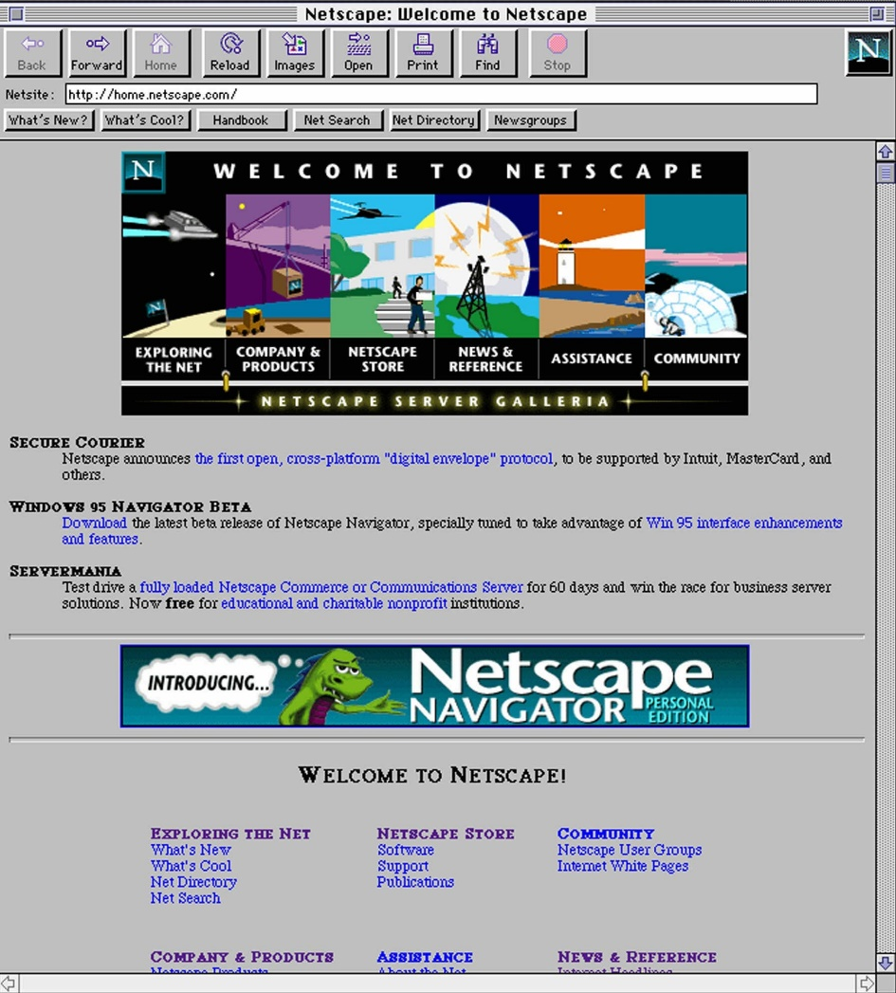
Before JavaScript – How Websites Worked
Before JavaScript, websites were static. Users could not perform actions like calculations or form submissions directly in the browser. For every action, a request had to be sent to the server, which processed it using its programming languages and returned a new HTML page. Every request caused the page to reload, so website speed was slow.
Key Points:
Page reload required for every calculation
Browser did not process calculations
Example Link: https://www.calculator.net/time-calculator.html

Slide 4
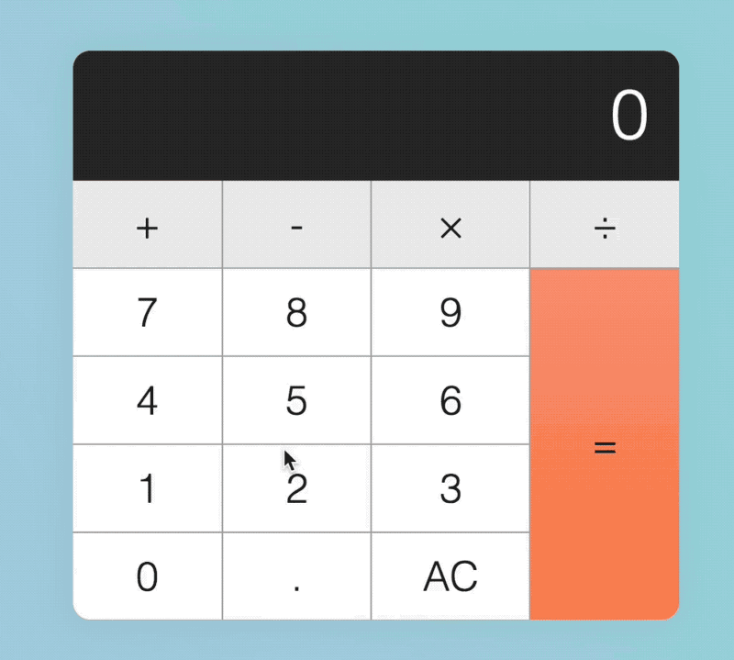
After JavaScript – How Websites Work
After JavaScript, websites became dynamic and interactive. Users can perform actions like calculations or form submissions directly in the browser without sending requests to the server. Results appear instantly and the page does not reload, making websites faster and smoother.
Key Points:
Instant actions in the browser without page reload
Calculations and form validations happen directly in the browser
Example Link: https://www.calculatehours.com/Time_Calculator.html

Slide 5
The Vision Behind Browser-Side Programming
Netscape’s founder, Marc Andreessen, had an idea to create a language that could run directly in the browser, allowing users to interact with web pages without sending every action to the server. This vision paved the way for the development of browser-side programming.

Slide 6

The Birth of JavaScript
To turn his idea into reality, Netscape’s founder Marc Andreessen hired Brendan Eich to create a language that could run directly in the browser. Brendan Eich successfully built this language in a very short time, laying the foundation for interactive web development.
Key Points:
Brendan Eich hired by Netscape in 1995
Task: Develop a browser-side programming language
Language created in just 10 days
Originally named Mocha
Renamed to LiveScript
Finally released as JavaScript

Slide 7
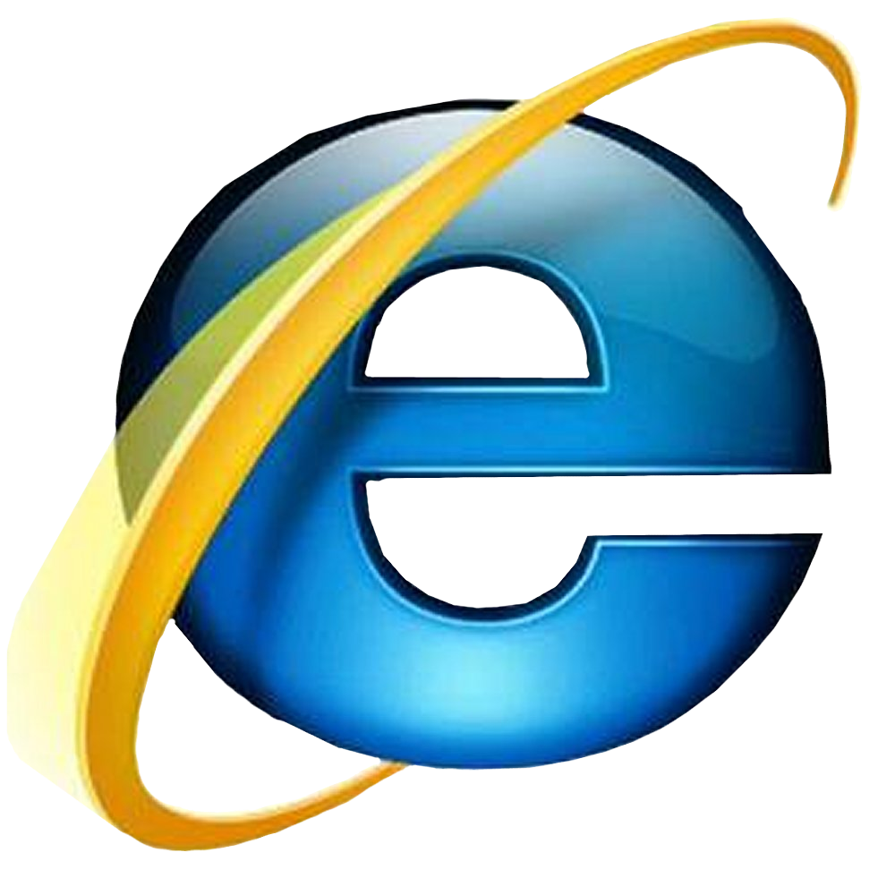
After JavaScript: The Browser Wars Begin
After JavaScript was introduced by Netscape and quickly became popular, Microsoft entered the browser market by launching Internet Explorer. To compete with JavaScript, Microsoft created its own version called JScript, which behaved slightly differently. This competition started the famous “Browser Wars.” As Microsoft aggressively pushed Internet Explorer, Netscape came under serious pressure, struggling to maintain its dominance in the browser market.

Slide 8

JavaScript Becomes a Standard
When Microsoft introduced its own scripting language, Netscape became concerned about JavaScript’s future. To avoid conflicts and protect the language, Netscape took JavaScript to ECMA, an international organization that creates computer and technology standards. ECMA standardized JavaScript under the name ECMAScript, making it consistent across all browsers.

Slide 9
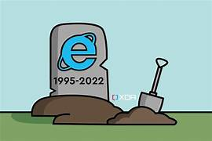
The Decline of Internet Explorer
After ECMA standardized JavaScript as ECMAScript, most developers and browsers started following this standard. However, Microsoft initially refused to fully adopt it and continued using its own approach in Internet Explorer. Over time, JavaScript evolved rapidly with many new features that Internet Explorer could not support. As a result, Microsoft eventually discontinued Internet Explorer, ending its resistance to modern JavaScript standards.

Slide 10
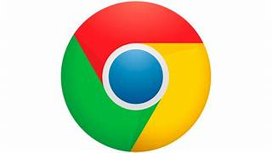
Chrome: The Browser Revolution
After the ECMAScript standard was established and web technologies started running smoothly, Google Chrome entered the market in 2008. It aimed to provide fast, simple, and secure browsing and quickly became popular worldwide.

Slide 11
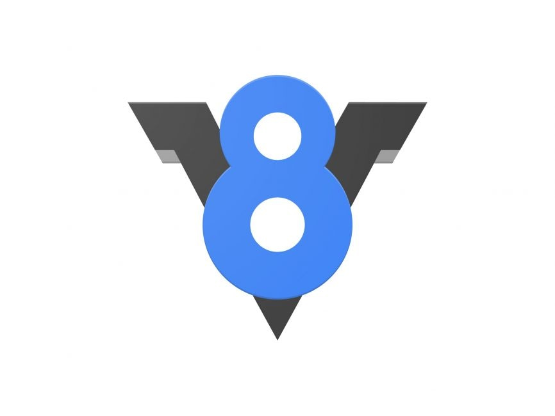
V8 JavaScript Engine
In 2008, Google introduced the V8 JavaScript engine with Chrome to drastically improve JavaScript performance. Unlike previous browsers, which interpreted JavaScript line by line, V8 compiles the code directly into machine code, making execution extremely fast. This allowed complex web applications to run smoothly and efficiently, setting a new standard for browser speed. The V8 engine also influenced other browsers, pushing them to optimize their JavaScript engines for better performance.

Slide 12
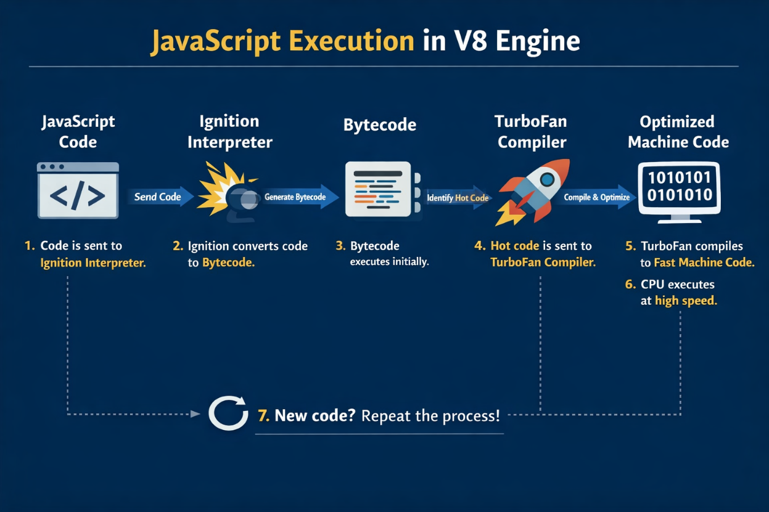
JavaScript Execution in V8 Engine
Step 1: New JavaScript code → Interpreter (Ignition)
Step 2: Interpreter converts code → Bytecode (initial run)
Step 3: Frequently run / hot code → TurboFan Compiler
Step 4: Compiler converts bytecode → Optimized Machine Code
Step 5: CPU executes machine code → super fast execution
Step 6: New / dynamic code → repeat process

Slide 13

Node.js: JavaScript on the Server
After the V8 engine made JavaScript super fast in browsers, a clever developer Ryan Dahl in 2009 took V8 out of the browser and created Node.js. This allowed JavaScript to run on the server, opening the door for backend development using JavaScript. Node.js made it possible to build fast, scalable, and efficient server-side applications with the same language developers already used in the browser.

